Slide 1

Data Analytics
Insights and
Recommendations
Insurance
Analytics
Customer Risk & Claims Analysis: Insurance Company Overview
DataForge Africa: Final Project
PRESENTED BY
Kopano Mofokeng
2024 - 2025
DATE
Report
28 April 2026

Slide 2

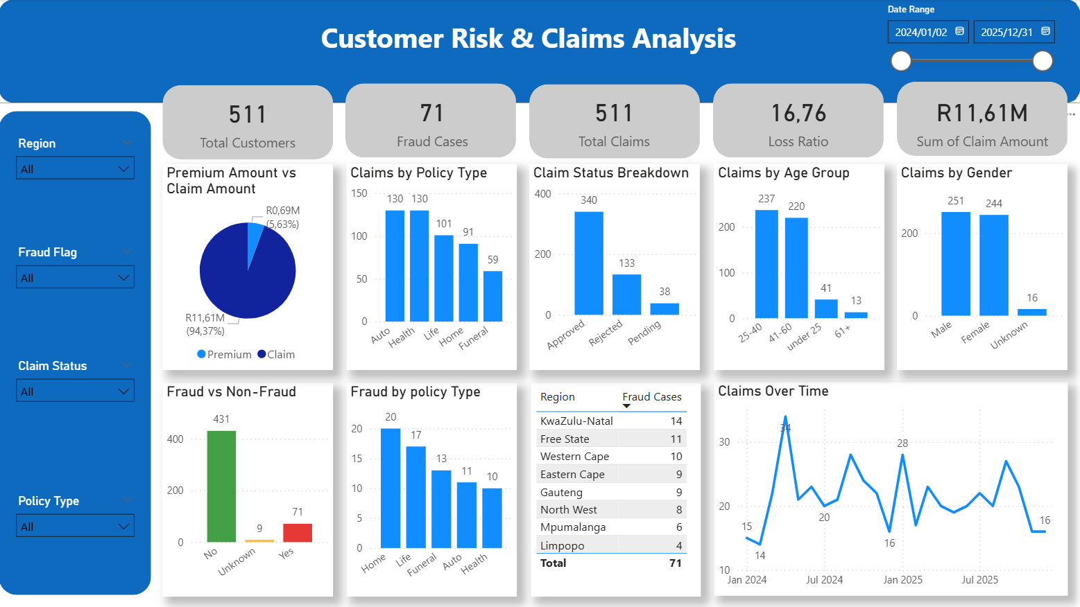

02
Questions to Answer
CLAIMS PAYOUT (R11.61M) VS PREMIUM (R0.69M)
What trends do you observe?
2. Which policy type is most risky?
3. Where is fraud most common?
4. Which customers or segments are high-risk?

Slide 3
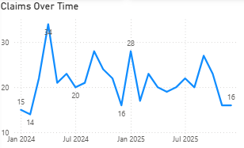
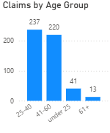
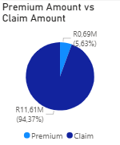

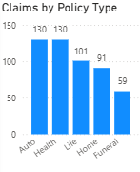
04
Key Trends
Health and Auto policies dominate claims
Claim activity is irregular throughout the year, with several months exceeding 25 claims.
Customers between 25 and 60 dominate with most claims
Claimed amounts are 17 times the premiums collected

Slide 4

Most Risky Policy Types
HEALTH INSURANCE: 130 CLAIMS
130
01
Health insurance leads jointly with auto all policy types with 130 claims, indicating high utilisation and potential need for enhanced risk assessment in this category.
HEALTH & AUTO INSURANCE CLAIMS
AUTO INSURANCE: 131 CLAIMS
02
HEALTH AND AUTO INSURANCE
Auto insurance also with 130 claims, proves to be a risky policy type. Together with Health, these two categories account for the majority of all claims and require focused attention.
Leads with 130 claims, both representing the highest volume across all policy types.
HOME INSURANCE: FRAUD RISK ALERT
LIFE INSURANCE
101 claims recorded, third highest among policy categories.
03
While Home insurance has lower claim volume, it records the highest fraud cases at 20 incidents. This signals a critical need for enhanced fraud detection and controls in this segment.
HOME INSURANCE
91 claims recorded, fourth highest among policy categories.

Slide 5




01
02
03
04
KWAZULU-NATAL: 14 FRAUD CASES
FREE STATE: 11 FRAUD CASES
WESTERN CAPE: 10 FRAUD CASES
OTHER REGIONS: LOWER FRAUD LEVELS
KwaZulu-Natal leads with 14 confirmed fraud cases, representing the highest concentration of fraudulent claims across all regions analyzed.
Free State recorded 11 fraud cases, ranking as the second highest region requiring enhanced monitoring and fraud prevention measures.
Western Cape accounts for 10 fraud cases, completing the top three high-risk regions that demand targeted intervention strategies.
Eastern Cape, Gauteng, and North West show comparatively lower fraud levels, indicating more stable risk profiles in these regions.
Fraud is concentrated in specific high-risk regions rather than evenly distributed. Targeted fraud detection and prevention efforts should prioritize KwaZulu-Natal, Free State, and Western Cape to maximize impact.
Fraud Analysis

Slide 6

08
High-Risk Customer Segments
SUMMARY OF SEGMENTS WITH ELEVATED RISK EXPOSURE
Age 25-60 years: Major claim contributors driving 457 total claims across the portfolio.
Policy Types: Health, Auto, Life show high claim volume; Home insurance has highest fraud cases (20).
Regions: KwaZulu-Natal (14), Free State (11), Western Cape (10) show concentrated fraud incidence.
Combined Risk: Intersection of age, policy type, and region factors creates highest exposure levels.

Slide 7
05
Financial Impact Overview
KEY FINANCIAL FIGURES SHOWING PROFITABILITY CHALLENGES
01
02
03
04
PREMIUM INCOME
BUSINESS IMPACT
CLAIMS PAYOUT
FINANCIAL GAP
~R0.69 Million total premium revenue collected
~R11.61 Million total claims paid out to policyholders
R10.92M+ shortfall where payouts significantly exceed premiums
Threatens long-term profitability and sustainability

Slide 8
09
Recommendations
02
04
ROOT
CAUSES
PRICING STRATEGY
High exposure in Health, Auto, Life policies; Regional fraud concentration; Working-age costs.
Implement risk-based pricing for high claim frequency and fraud exposure segments.
GROWTH
FOCUS
FRAUD CONTROLS
01
Strengthen detection in high-risk regions; Focus controls on Home insurance.
03
Target lower-risk segments for growth; Apply stricter controls for age 25-60.

Slide 9

Thank You!
Questions and
Discussion
Welcome
Data Analytics
Insights
Action Plan:
• Develop enhanced fraud detection in high-risk regions
• Revise pricing models with risk data
• Establish Home insurance fraud monitoring
• Launch customer engagement campaigns
• Schedule regular claims reviews
081 357 3364
kopanom012@gmail.com
10
www.linkedin.com/in/kopanomofokeng/
of 10

